Slide 1
HOGIST Online Catering Service
Done by
Boopathiraja K
Gawtham

Slide 2
ABSTRACT
We have created a Website about to order the food for Party, Marriage, Industry, and Corporate. And get the information about the Foods that are available for the various kind of party.
The Contact details that are available that the client can directly contact with the managing person and can manage the orders with the personal messenger. And the Company, available locations can be shared within the quick links.

Slide 3
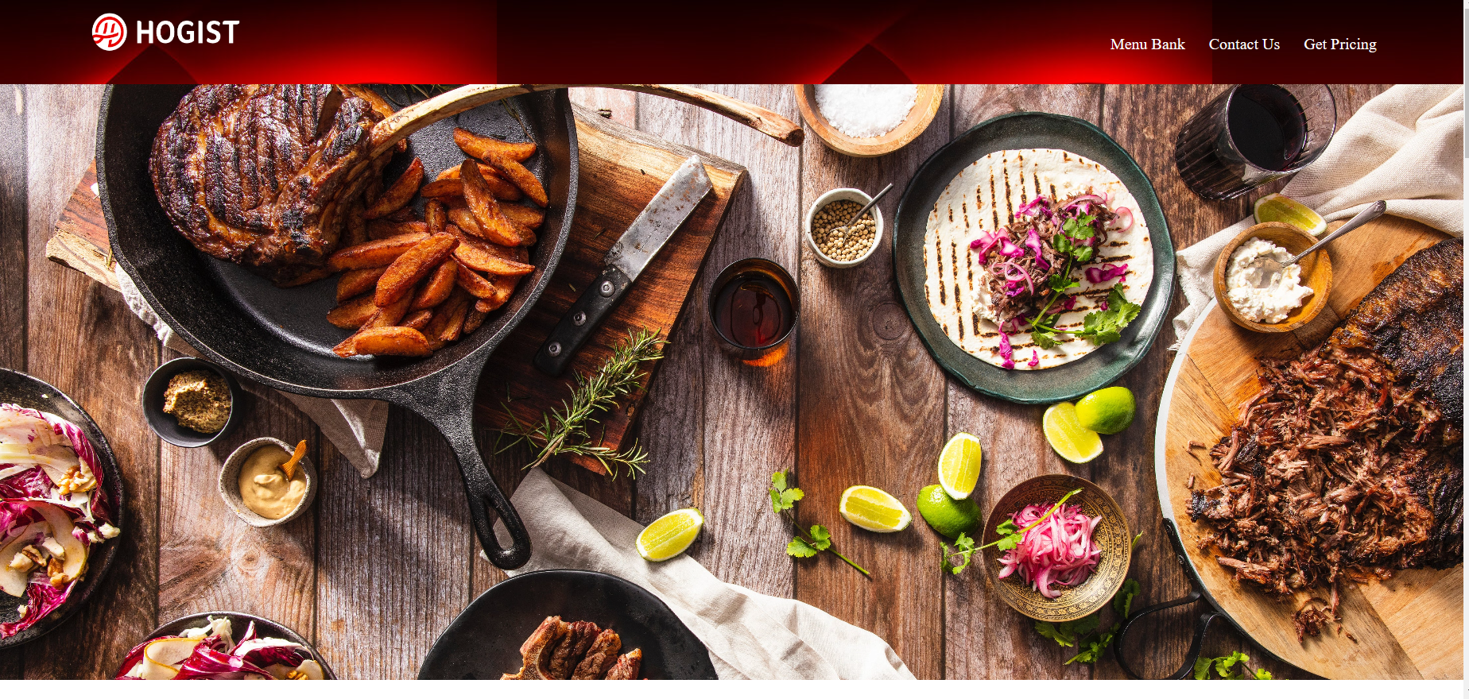
LANDING PAGE

Slide 4
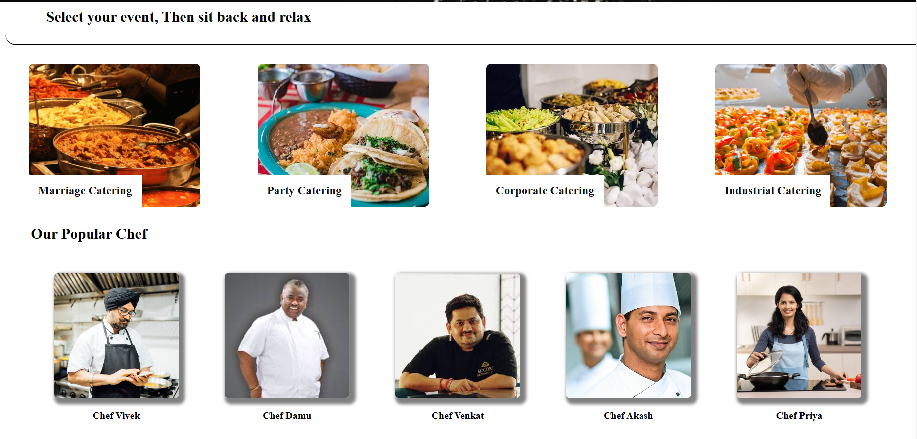
OFFERED EVENTS

Slide 5
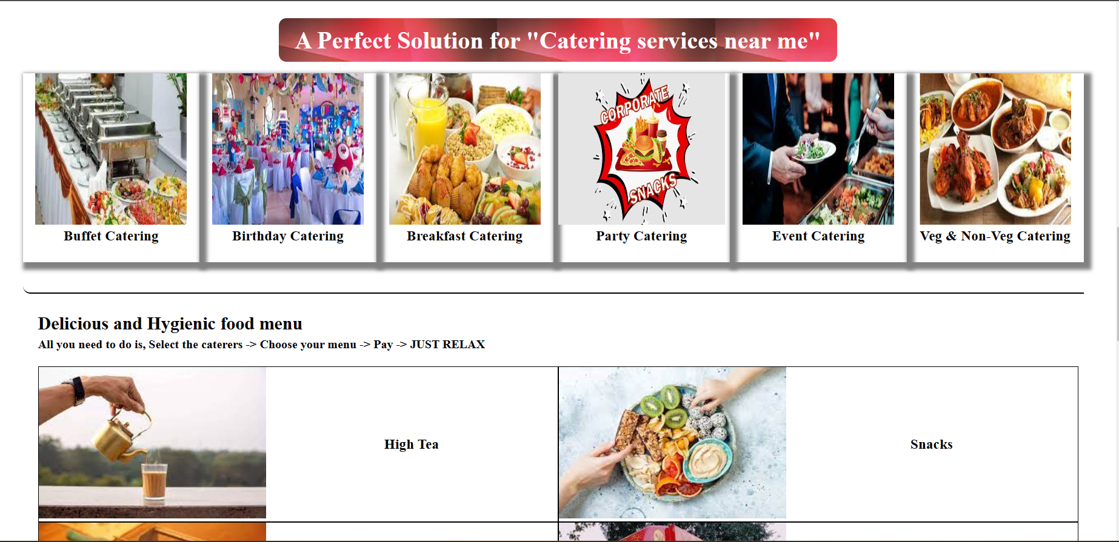
ADDITIONAL EVENTS

Slide 6
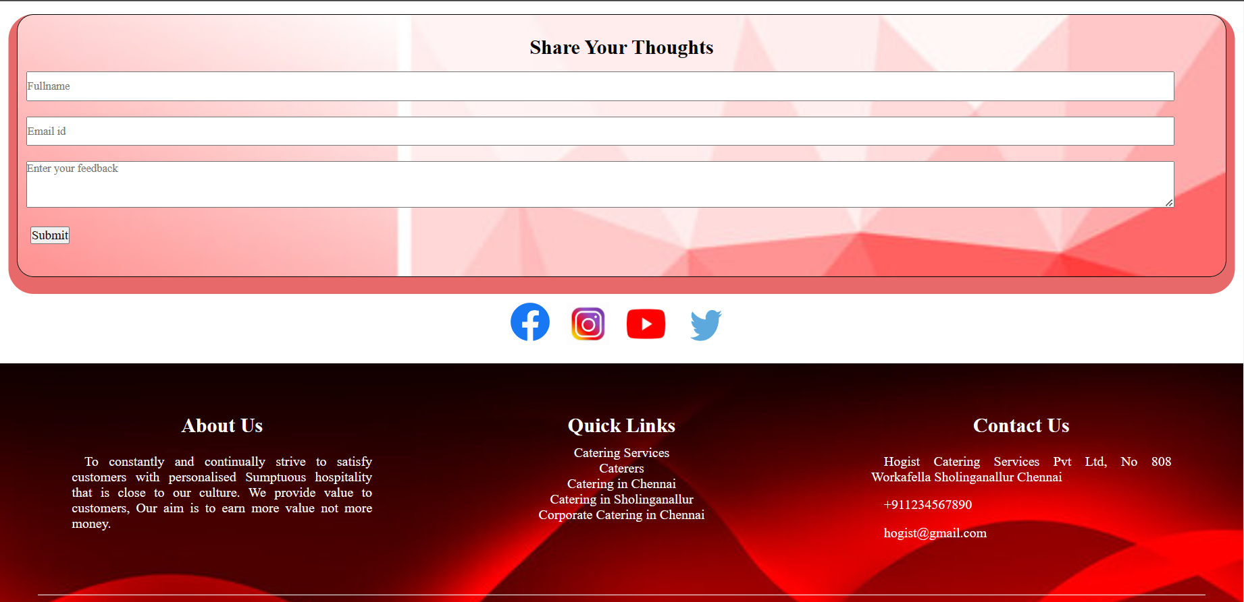
FEEDBACK

Slide 7
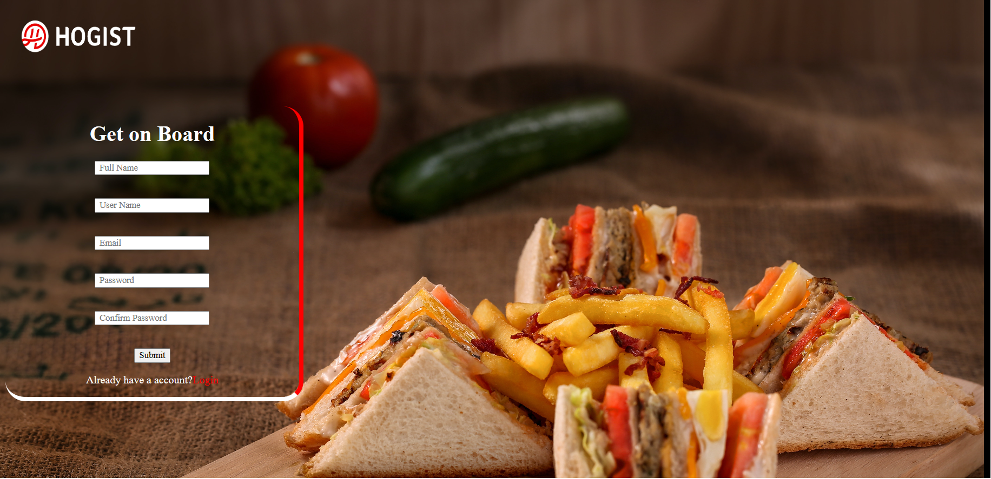
SIGNUP PAGE

Slide 8
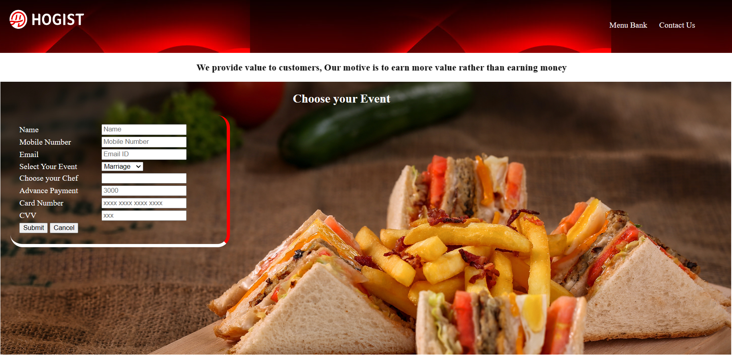
ORDER PAGE

Slide 9
THANK YOU

